Slide 1
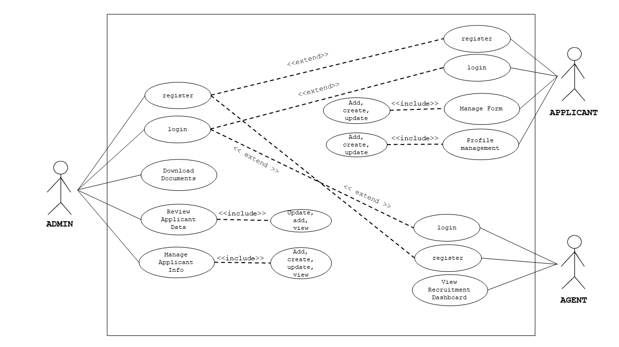

Browse
Submit Required Documents
Communication
<< extend >>
CLIENT
Track Application
Communication

